Slide 1
Smart Ticket & Issue Management System
V. Lakshmi Varaprasad Reddy Chubb Ate Java Track

Slide 2
The Problem We Are Trying To Solve
Inefficient Tracking :
Manual email and spreadsheet-based ticket tracking creates bottlenecks and errors in support workflows.
Operational Blind
Spots Limited visibility into real-time ticket status, priority levels, and total resolution time.
Communication Gaps
Poor coordination between frontline support agents and management teams.
Performance Metrics
Minimal reporting capabilities for SLA compliance and overall team performance tracking.
Decentralized Processes
No centralized system for ticket assignment and escalation leads to delayed responses.

Slide 3
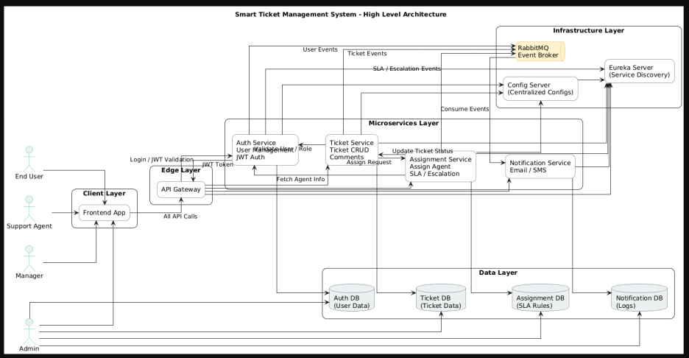
System Architecture Overview
A comprehensive microservices architecture designed for scalability, reliability, and intelligent ticket routing across distributed systems.

Slide 4
7 Independent Microservices
Auth Service
Authentication & Authorization
Ticket Service
Core ticket management
Assignment Service
Smart ticket routing
Notification Service
Real-time alerts
Api Gateway
Request routing
Eureka Server
Service Discovery
Config Server
GitHub Properties

Slide 5
Technology Stack
Spring Boot & Spring Cloud for microservices framework
MySQL & MongoDB for hybrid data storage
RabbitMQ as message broker for async communication
Docker & Docker Compose for containerization
JWT Authentication for secure access control

Slide 6
Database Design Strategy
Ticket System
Auth Db(My Sql)
Notification Db(My Sql)
Assignment Db(My Sql)
Ticket System(MongoDb)
Roles
Users
Notification
Assignments
Sla
Sla Events
Sla Rules
Comments
Attachments
TicketCollection

Slide 7
My Sql Schema
1 Users Table Authentication credentials and comprehensive user profiles for all system participants.
2 Assignments Table Complete ticket assignment history tracking for accountability and audit trails.
3 Notifications Table Event notifications and alert management for real-time communication.

Slide 8
MongoDb Collections
Comments Collection — Embedded comments within ticket documents enable threaded conversations and collaboration history
Tickets Collection — Flexible schema design accommodates complex ticket structures with extensible properties and dynamic fields.
Attachments — File URLs and metadata storage for supporting documentation and evidence.

Slide 9
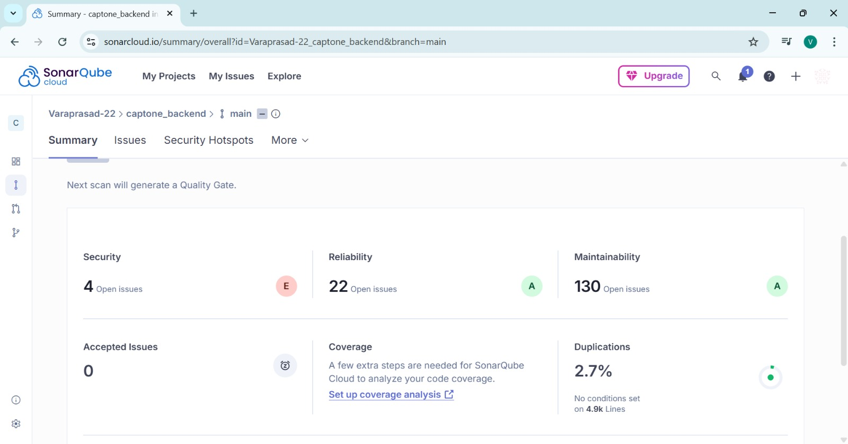
Sonar Qube Reports

Slide 10
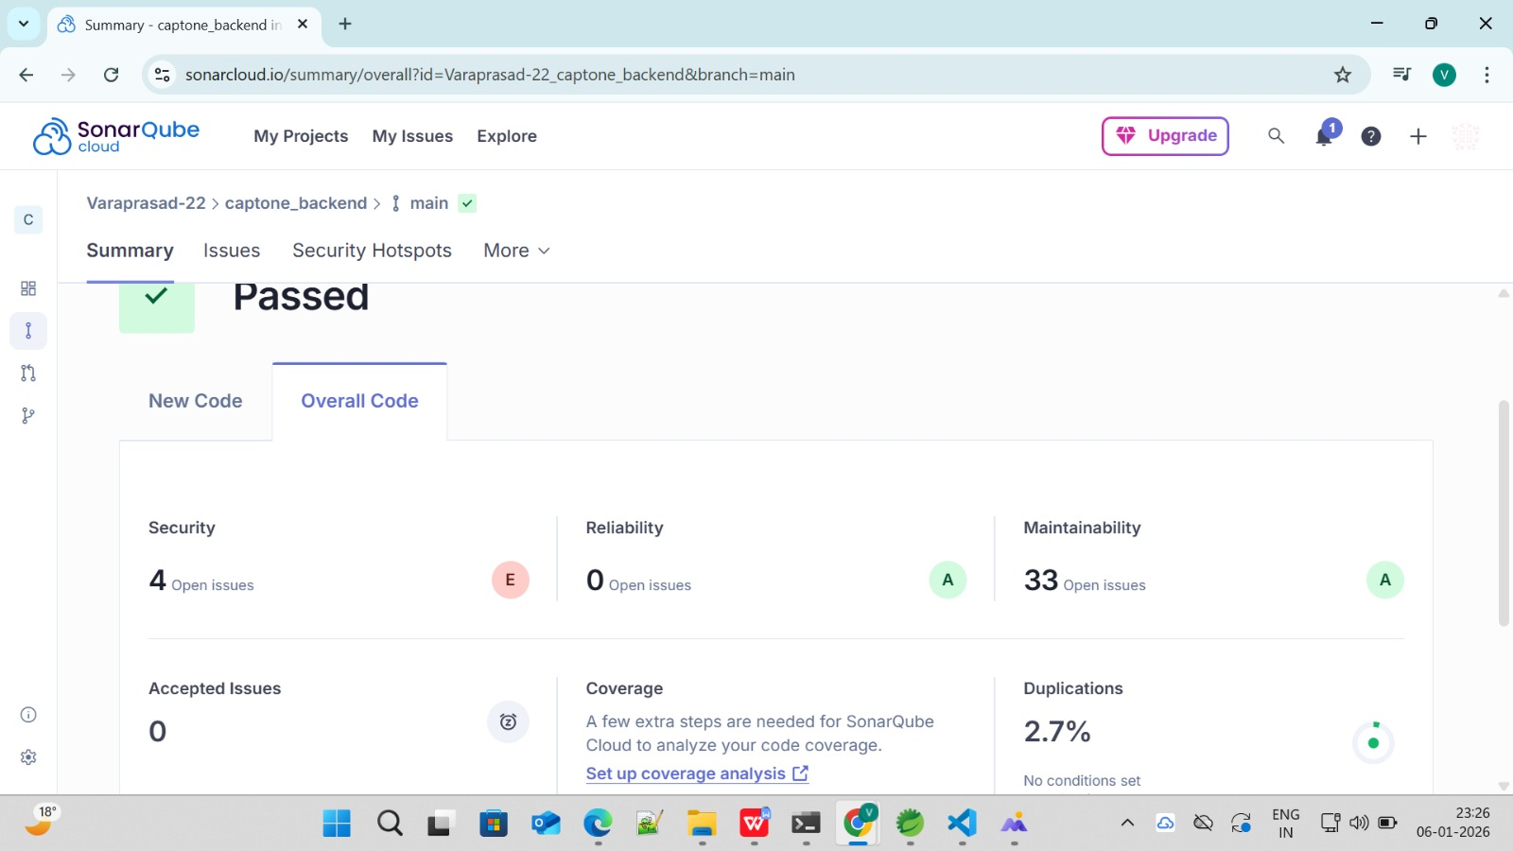

Slide 11
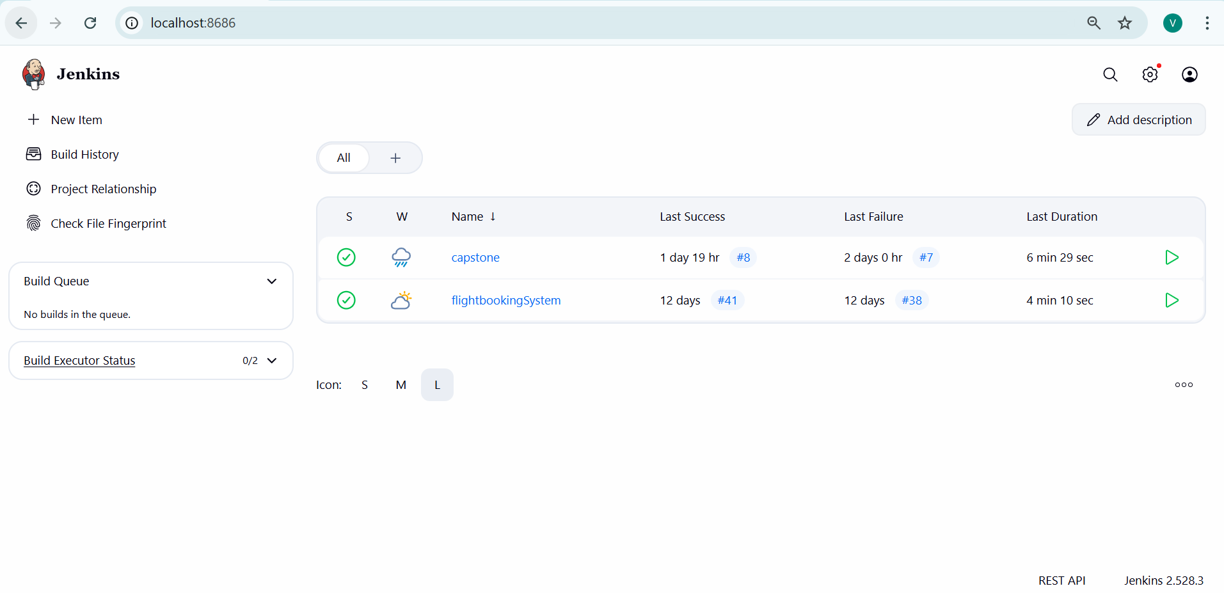

Slide 12
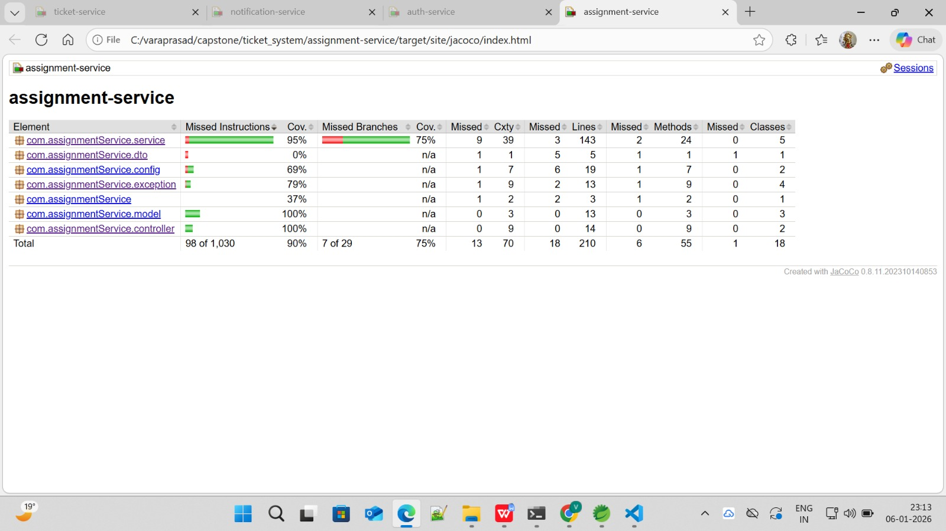
Testing Reports

Slide 13
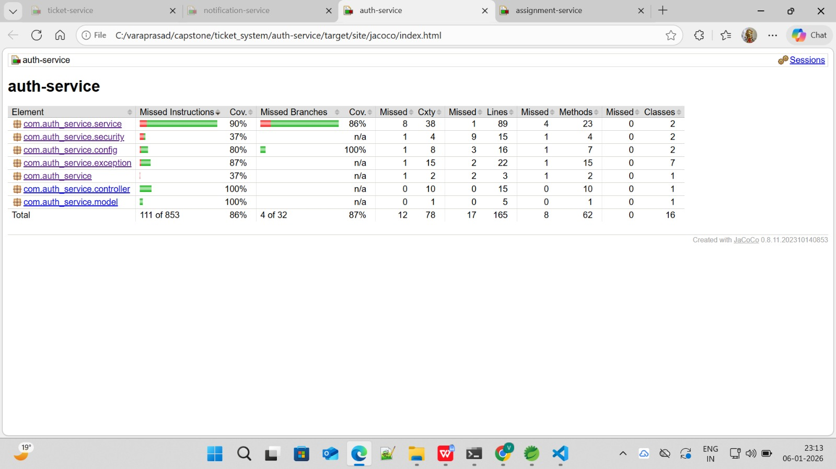

Slide 14
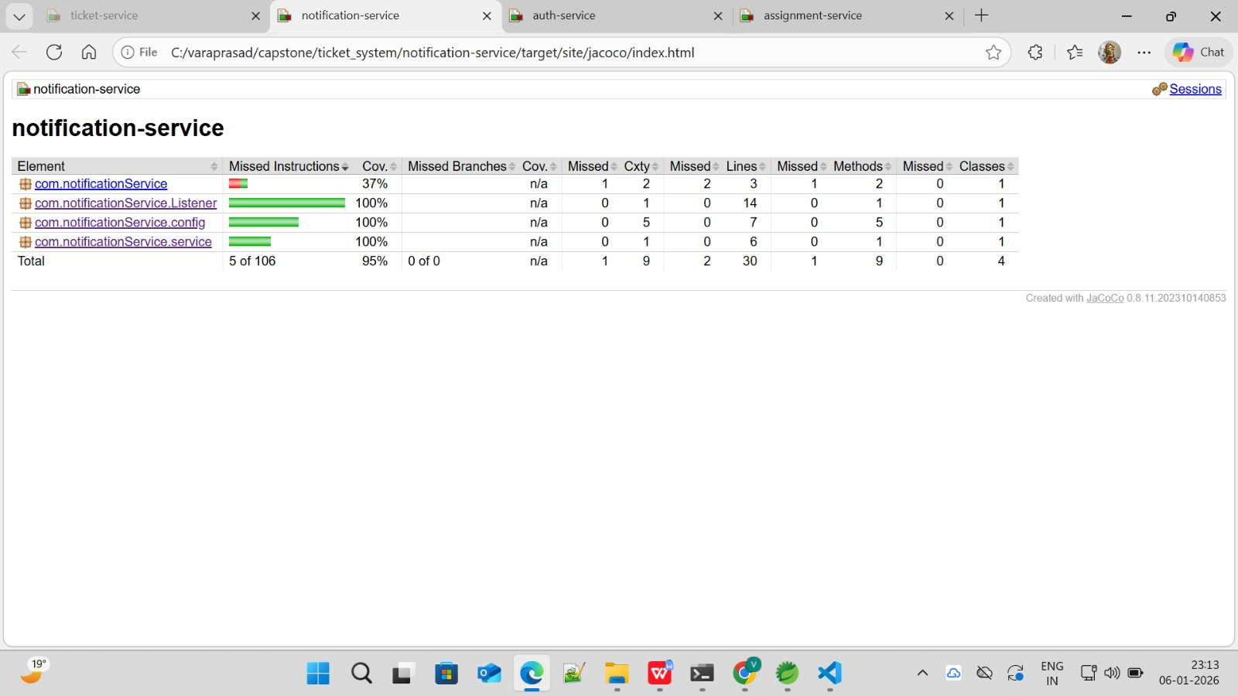

Slide 15
